Slide 1

Building a Native App for Windows in 2025
Which UI Framework Should You Choose?
Notes:
Welcome! Not a bad crowd for the lunch hour.
We’re going to be talking about native UI frameworks for Windows development, focusing on the choices for .NET developers.

Slide 2
About Me
Software Developer & Architect for 25+ years
.NET / C# / WPF / Angular / SQL Server​
Morning Dew link blog – www.alvinashcraft.com
Daily links for developers since 2007​
Author of three books​ for Packt Publishing
Learn WinUI 3 (1st & 2nd editions)​
Parallel Programming and Concurrency with C# 10 and .NET 6​
Joined Microsoft in March 2022​ - Sr. Content Developer
Content team > Learn > Azure Core org​ > Cloud & AI (under Scott Guthrie)
Windows Developer Documentation (Win32 / WinRT / Windows App SDK)​
TechBash Developer Conference - Poconos
Organizer since TechBash 2016
TechBash Foundation - Founding board member since 2015
Notes:
A little bit about me…
For those who don’t know me, I’ve been working in the software industry since 1995, with most of that time (over 25) years spent as a developer and architect using various Microsoft technologies.
Some of you may also be familiar with my blog, the Morning Dew, where I’ve been posting daily links for .NET developers for 17 years.
I’ve also written three books in the last four years, two editions of Learn WinUI 3 and a book on parallel programming with C# and .NET. You can find them all on Amazon. Just search for my name.
Writing those books led me to a full-time career in writing. I joined Microsoft about two and a half years ago as a content developer. I write documentation, training modules, and code samples on Microsoft Learn, working on the Windows developer docs team. There, I help write and maintain the docs for Windows client apps and APIs.
I have another session after lunch about my work as a content developer and how anyone can contribute to the open-source docs on Learn with GitHub Issues and PRs.
And… in my spare time, I’m also a conference organizer.

Slide 3




November 4-7, 2025 | Pocono Manor, PA
Great speakers with top content
A fraction of the cost of the more crowded conferences
- 3-day conference plus lodging for ~$1000
Full-day deep dive preconference sessions available
Easy travel from almost anywhere
World-class keynotes
In addition to the sessions, you get a great hallway
Track, amazing food, attendee Welcome Reception, Game Night & more
Family Day Friday - full day of kids' sessions, free for attendees' families
Discounted Kalahari Resort rooms with water park access: stay, learn & play all week
https://techbash.com or @techbash
Notes:
TechBash is coming back for our 7th year. We started in 2016 and took a couple of years off in the middle like most conferences.
Everyone here is familiar with the Kalahari. Come check out ours in the Poconos! Our call for speakers will be opening in mid-February, so keep an eye on our website and on social media.

Slide 4

Agenda
A brief history of Windows development
Today’s Choices – Pros & Cons
Windows Forms
WPF
UWP*
WinUI
.NET MAUI
Uno Platform, Blazor Hybrid & Avalonia
PWA (not discussed)
Guidelines when choosing a framework
Resources and Q&A
Notes:
Let’s get to today’s agenda.
We’ll start with a brief review of Windows development’s evolution since the introduction of .NET Framework.
Then we’ll review some reasons why you might decide to choose each of these UI frameworks, followed by a look at some code for each of them.
I created the same sample app using each framework. It’s a very basic shopping list app that loads some sample data. Each app shares the same code to generate the sample data. You can add more items, mark them as purchased or remove them from your list. We’ll see the similarities and differences, and you’ll see that I’m probably not cut out to be a UI designer, no matter which framework I use.
We’ll finish up with some guidelines you can use when selecting a framework for your next Windows project.
And we’ll review some online resources you can keep handy, and we’ll have some time for Q&A. But feel free to ask questions as we go.

Slide 5
.NET Desktop App History
2002 - Windows Forms (WinForms)
Successor to VB 6 forms
Bill Gates demo of Visual Basic form designer in 1991: https://youtu.be/Fh_UDQnboRw?si=vO9IUCn05qW_w8PO
2006 – Windows Presentation Foundation (WPF)
2015 - Universal Windows Platform (UWP)
Successor to Windows 8.x apps - 2012
2021 - WinUI and Windows App SDK (March)
2021 – Blazor Hybrid (November)
2022 - .NET MAUI (Multi-platform App UI)
3rd Party Cross-Platform Options
Uno Platform (UWP/WinUI XAML)
Avalonia UI (WPF XAML)
Notes:
This is a simplified timeline of UI frameworks for .NET developers since .NET’s introduction in 2002.
WinForms has been there for every step of the way. Even before WinForms and .NET, Microsoft has had a forms designer for Windows apps. In 1991, Bill Gates demoed the first VB form designer.
WPF was introduced with Windows Vista in 2006 and was the first XAML-based UI framework from Microsoft. WPF became a big deal for enterprise developers, and quickly became the de-facto choice for businesses building enterprise Windows apps.
We’ll skip over the Windows 8 XAML apps that debuted in 2012 and talk briefly about UWP apps. They were introduced in 2015 with Windows 10, and UWP apps gave developers a way to target Windows on desktops, phones, HoloLens, and Xbox with a single code base. They had some success with ISVs building consumer apps but never got much traction in the enterprise. WPF stayed strong there.
2021 gave use two new options for Windows apps, WinUI 3 (and the Windows App SDK) and Blazor Hybrid apps. WinUI 3 was launched as a successor to UWP, and Blazor Hybrid apps introduced a way for web developers to build desktop and mobile clients with .NET and Razor pages.
We’ll also talk about some options that allow you to target multiple platforms. .NET MAUI is the successor to Xamarin.Forms, and it allows you to use XAML and C# to build apps for Windows, macOS, and mobile devices. There are some third-party options that we’ll touch on too. Uno Platform and Avalonia UI both target the same platforms as MAUI in addition to Linux and web support (with WebAssembly).
If we had more time, we could also talk about some non-.NET options like Flutter, React Native for Windows, and Electron.

Slide 6
But what about…
In the interest of time, we’re staying focused on frameworks of interest to .NET developers.
These options are all valid for the right team and project:
React Native for Windows
Progressive Web Apps (PWAs)
Electron.js
Web apps – in your browser of choice
Win32/C++
VB6 ☺
Notes:
We won’t have time to talk about every option available for building apps for Windows. With only 60 minutes and quick demos of each project to get to, we’ve omitted plenty of great options.
React Native for Windows is a great option if you’re a JavaScript developer, as are PWAs and Electron apps (if you users have plenty of RAM).
You could keep your app in the browser with JavaScript, Blazor or ASP.NET Core.
If you’re a hardcore C++ developer, there are new Win32 APIs coming in every new Windows SDK release.
And then there’s VB6.

Slide 7
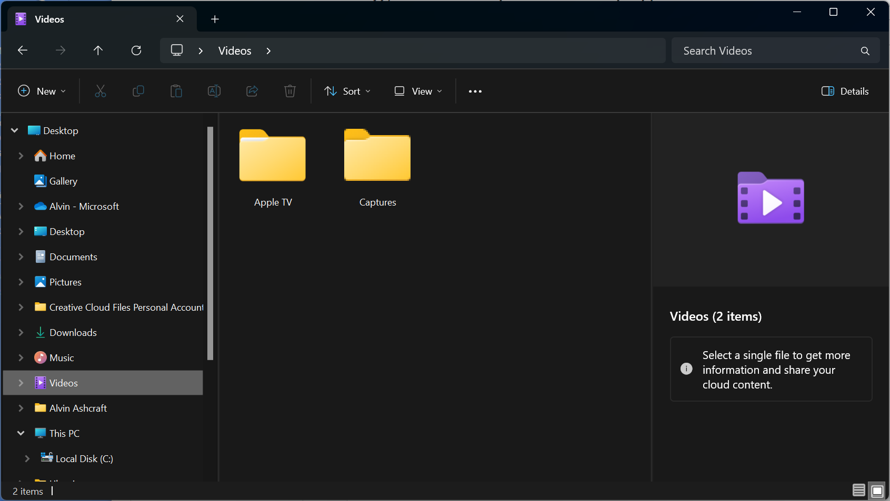
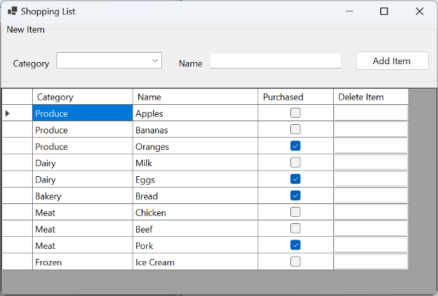
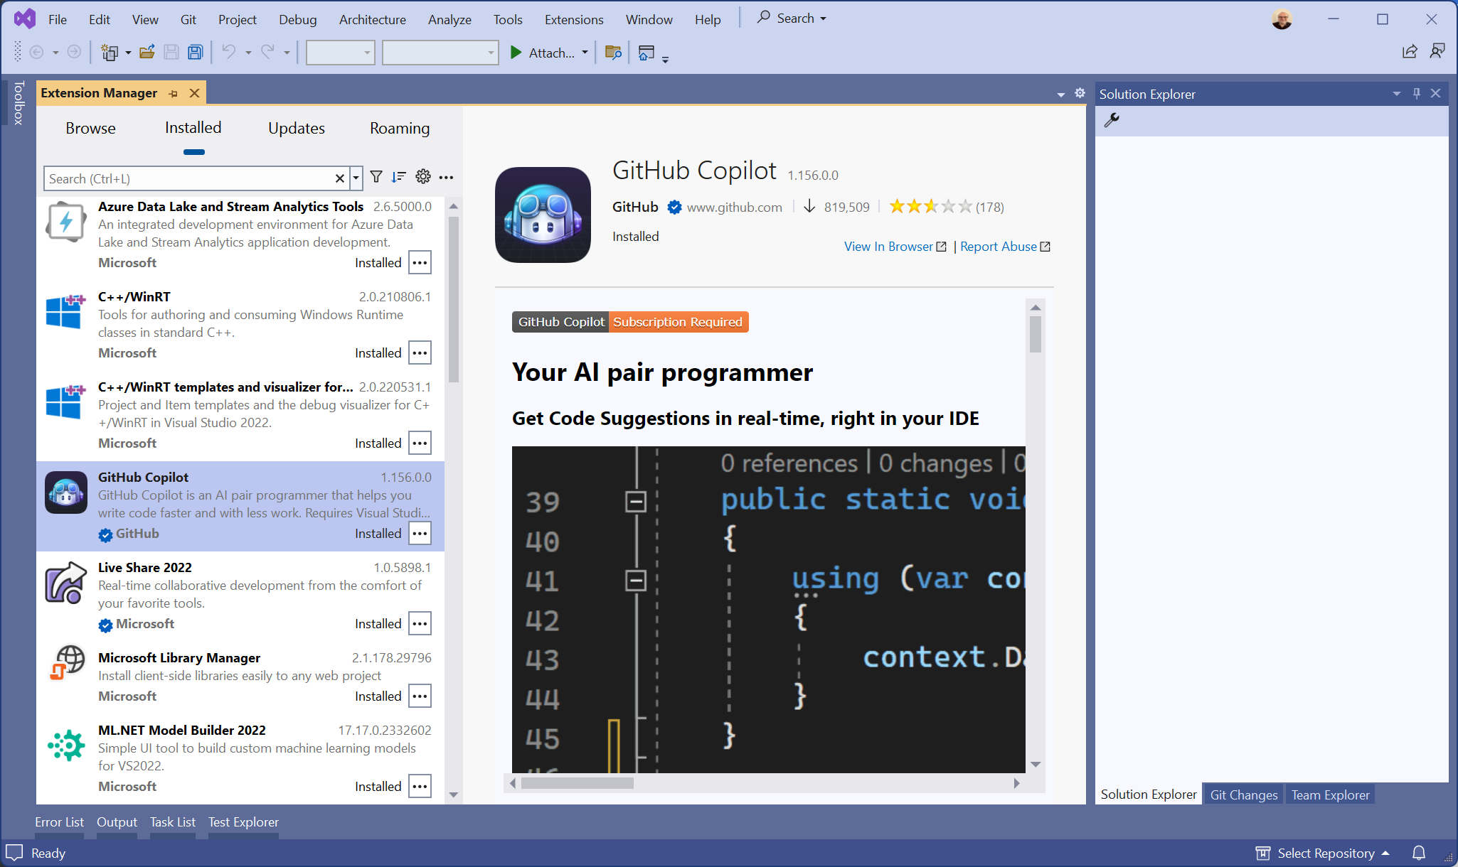
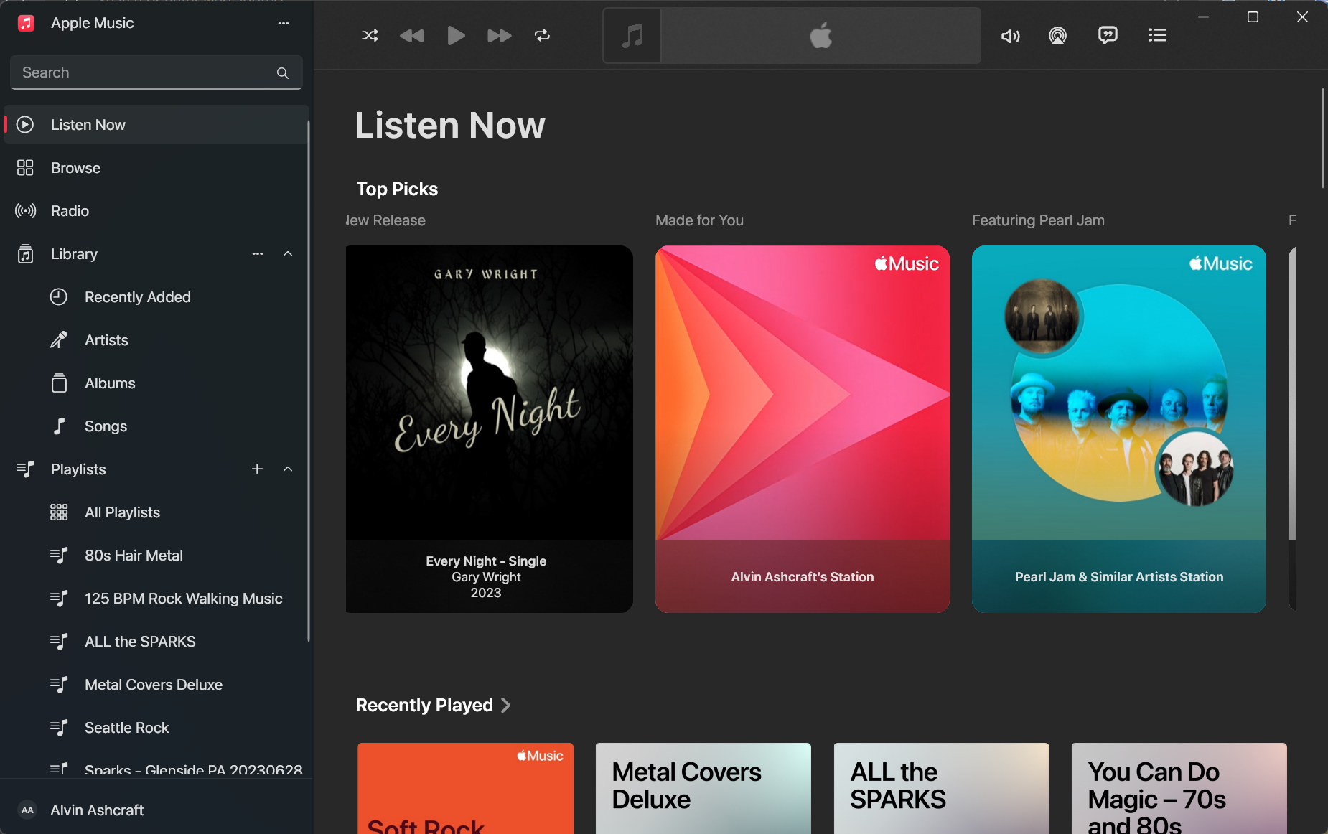
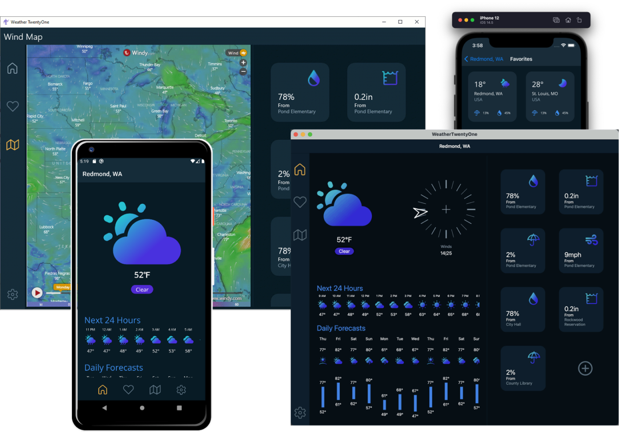
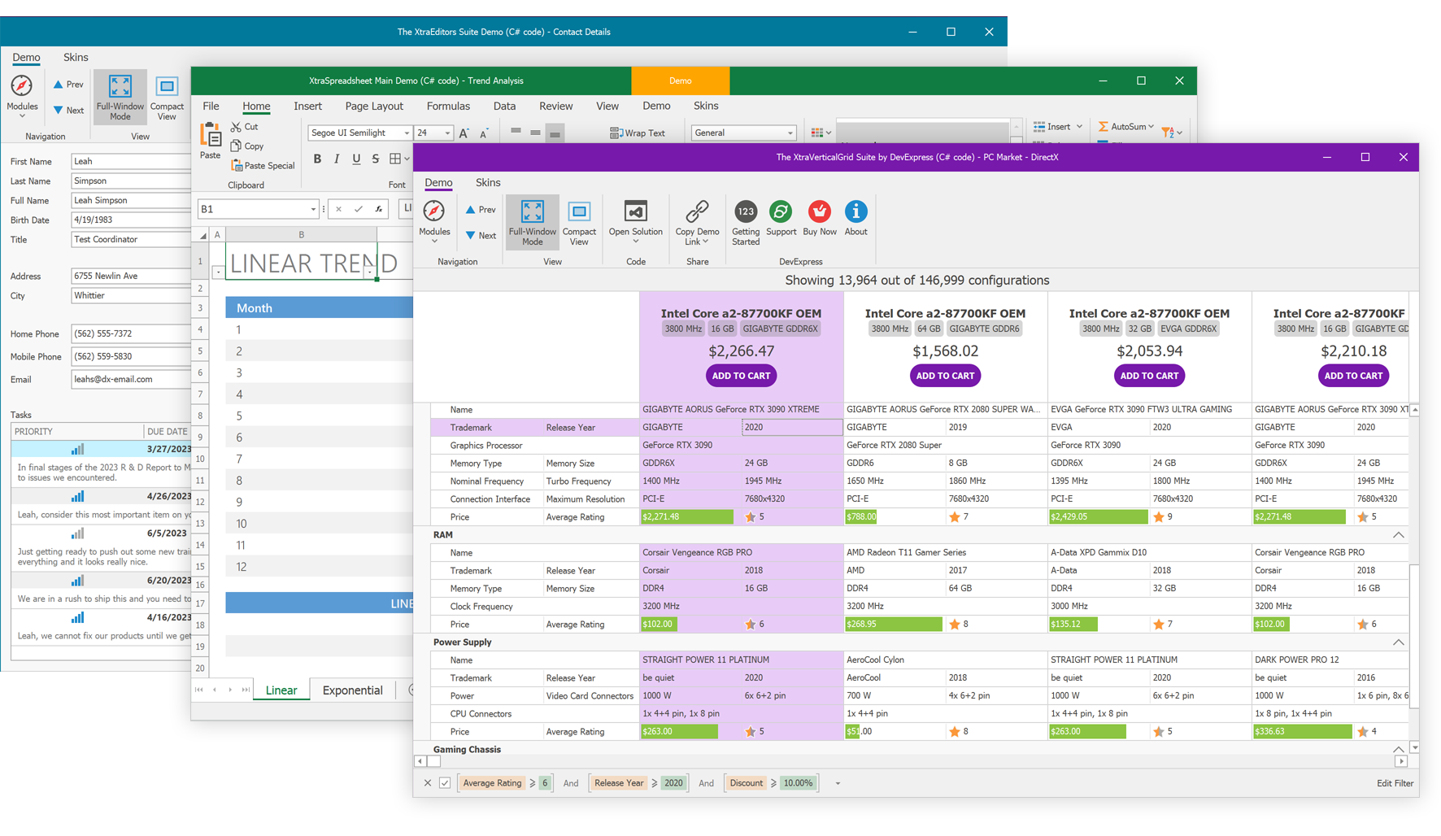
User Interface Examples
Notes:
These are a few examples of Windows UIs that were created with some of the frameworks we’re discussing today.
The two on the left are both WinForms.
The upper-left screenshot is probably the type of UI you picture when you hear Windows Forms. It looks very Windows 7… utilitarian. This is a screenshot of the sample app will be exploring later in this session.
The lower left is a WinForms UI with some third-party controls and theming applied. This particular example was taken from DevExpress. With the help of third parties, there’s a lot you can create with modern .NET’s Windows Forms.
The screen in the middle probably looks familiar. That’s Visual Studio 2022. Nearly all the Visual Studio UI is WPF. There are a few remaining legacy dialogs (like the Options dialog), but it’s mostly WPF.
The screens below Visual Studio were created with .NET MAUI. Microsoft built a weather sample app that’s responsive to different desktop and mobile form factors. You can get the source code for this app on GitHub. Just search for .NET MAUI weather sample app.
The top right image is a screenshot of Windows File Explorer in Windows 11. The latest builds of Windows 11 have a File Explorer that was created with WinUI. Microsoft and some key partners like Apple and Adobe have been using WinUI to create some high-profile desktop apps over the last couple of years.
The Apple Music app is the last image here. You can download the Apple Music, Apple TV, and Apple Devices apps from the Microsoft Store. All three were built with WinUI. Adobe’s WinUI app is called Fresco, you can also install Fresco from the Microsoft Store.

Slide 8
Windows Forms Advantages
Rapid UI development with forms designer and data binding
Third-party control support
Modern and legacy options
.NET Framework to target legacy Windows
.NET 9 for modern language features and performance
Upgrade .NET Framework apps to modern .NET with Visual Studio
Active Development (Async, Accessibility, High DPI, Performance, Dark Mode experimental in .NET 9)
Roadmap: https://github.com/dotnet/winforms/blob/main/docs/roadmap.md
Every C# (or VB) developer is already a WinForms developer
Notes:
Let’s get into some details with each framework, starting with Windows Forms. WinForms is probably still the most used Windows framework when it comes to starting a new project.
.NET developers love WinForms because it lets you build apps fast. It has a visual drag & drop designer to build your UI, and everything is C# (or VB) code. There’s no separate language or markup used to build the UI.
As we saw on the previous slide, there has been strong third-party support for WinForms controls for years (decades, really).
You have two options when you create a new WinForms project. You’ll typically want to select the modern .NET option (that’s .NET 9 today), but you still do have the option to create a new WinForms project on .NET Framework. The templates for both are part of Visual Studio 2022. If you have clients running unsupported Windows 7 machines, you can still build and maintain .NET client apps for them.
If you have existing .NET Framework WinForms apps that you’d like to modernize, Microsoft has a .NET Upgrade tool you can use to move them to .NET 9 to take advantage of the performance and features of today’s .NET.
This tool can also upgrade legacy WPF apps to WPF on .NET 8, Xamarin.Forms apps to .NET MAUI, or UWP apps to WinUI. The tool will also provide a list of any issues encountered during the upgrade.
Windows Forms is still supported and under active development. There are some new async APIs and experimental Dark Mode support in .NET 9. You can visit this page on GitHub to review their public roadmap and see upcoming features.
Because there’s no XAML, CSS, or any other UI language to learn. Every .NET developer can be a WinForms developers.

Slide 9

Windows Forms Drawbacks & Demo
It looks like Windows Forms – Dated UI
No support for Windows Fluent Design
Looks like Windows XP or 7
No GPU acceleration
No C++ support
No production support for Windows themes (Dark Mode)
Experimental support in .NET 9
Third-Party Theming Options
Not optimal for Touch and Pen input
Notes:
Let’s briefly touch on a few reasons why you might not choose Windows Forms, and then we’ll look at the sample app.
Without any custom theming applied, WinForms looks dated. It’s had some updates to improve the UI over the years, but you won’t be implementing Microsoft Fluent Design in a WinForms app any time soon.
The XAML-based frameworks can take advantage of rendering on modern GPUs, improving the performance of complex UIs.
There’s no C++ language support for WinForms projects (or F# for that matter). It’s C# and VB only.
The built-in support for switching between light & dark themes when users update their Windows theme has been added as an experimental feature in .NET 9. We also saw earlier that there are third-party theming options for with light and dark themes though.
It’s also not the best choice if touch input or inking are important to your users.
OK, let’s look at some code!

Slide 10

WPF Advantages
Extensible Application Markup Language (XAML) designer
XAML Hot Reload for UI debugging
GPU Accelerated UI – DirectX pipeline
Rich data binding with MVVM pattern
Modern and legacy support (.NET Framework and modern .NET)
Extensive 3rd Party control and library support (Theming)
Active development
Roadmap: https://github.com/dotnet/wpf/blob/main/roadmap.md
Windows 11 theming support and UI refresh in .NET 9
Great for native Enterprise apps with multi-window experiences
Notes:
Next up is WPF…
WPF apps have a XAML-based UI. If you’re not familiar with XAML, it’s a schema-bound XML markup language with support for data binding, styles, and loading static and dynamic resources.
Visual Studio provides a UI designer for WPF, as well as XAML Hot Reload for making simple UI changes while debugging without having to stop and start your debugging session. Visual Studio doesn’t always generate the best XAML when adding or moving items in the designer, but it’s a great tool for learning or to use as a preview tool when manually editing the XAML.
As I mentioned on the WinForms slide, XAML-based UIs are GPU accelerated, which means they’re rendered by the DirectX pipeline. This helps with UI rendering performance, offloading some work from the CPU.
Data binding in WPF is extremely powerful and lends itself to using the Model-View-ViewModel (or MVVM) pattern. Visual Studio also has tools for debugging data binding errors and for analyzing the WPF visual tree – that’s the hierarchy of controls/elements in the UI.
Like WinForms, WPF has .NET 8 and .NET Framework project options and extensive third-party library support.
It’s under active development, and if you check out the roadmap on GitHub, you’ll see that they’re working on built-in theming support for Windows 11 in .NET 9. WPF apps will finally have a more modern look out-of-the-box. We’ll see it today in the .NET 9 preview.
WPF is the framework of choice for many companies building complex line-of-business apps for Windows today.

Slide 11

WPF Drawbacks & Demo
XAML learning curve
No C++ support
No current support for Fluent Design
Default UI still looks like Windows 7 or Vista
.NET 9 fixes this!
Better for Touch and Pen input but not best in class
UI Performance Not as optimized as UWP/WinUI
Notes:
The primary downside for many developers considering WPF is the XAML learning curve. I love working with XAML, but it’s not everyone’s favorite way to build a UI.
Like WinForms, it’s C# and VB only. There’s no C++. If you are a big F# fan, you could create a minimal UI project with only the C# views and create a separate F# project for your view models, business logic, and everything else.
With .NET 9, we finally get to remove the bullet points about how dated WPF looks out of the box.
It’s better for touch and pen than WinForms, but it wasn’t built for today’s devices like WinUI.
Performance-wise, it’s better when you use .NET 8, but there are some improvements in the rendering pipeline that make UWP and WinUI user interfaces smoother.
Let’s look at the WPF sample app next.

Slide 12
UWP Advantages*
.NET Native optimization
Built to perform on Windows, Xbox and Windows Phone with limited resources
Xbox Support (and HoloLens)
XAML Designer
Great for Touch and Pen input
Windows Theme support (dark mode)
Rich data binding support with MVVM
WinUI 2.x controls and libraries (Some Fluent Design support)
Security with Windows Sandboxing (AppContainer)
New preview support for .NET 9
Notes:
Let’s briefly talk about UWP apps next. We’ll touch on some advantages, but the drawbacks on the next slide should weigh heavily on your decision.
Thanks to Windows Phone, UWP apps are optimized for performance. They are small and memory-optimized with the .NET Native runtime.
It technically supports HoloLens and Xbox, but HoloLens is officially deprecated, and I haven’t heard folks pushing UWP developers to build Xbox apps in a long time.
Like WPF, Visual Studio has a XAML designer for drag & drop UI building.
UWP apps were built for pen and touch and provide dark mode support.
Like all XAML languages, you have data binding and testability with MVVM.
The WinUI 2 libraries provide some additional controls with some Fluent design support, and additional helpers & styles.
UWP apps are sandboxed, which means they have limited access to the file system and other Windows resources. This provides users some additional security from bad actors. Like mobile apps, they need to declare any advanced capabilities or access required so users are aware of what data might be accessed. There’s something like this coming for all packaged desktop apps called AppSilo, which should be released in the fall.
And now in preview in .NET 9, you can create UWP apps with the latest .NET and C# features. This was added to ease migration to WinUI and also to get people off of the old .NET Native runtime. UWP is still in maintenance mode. No new features…. Which brings us to the cons.

Slide 13

UWP Drawbacks & Demo
No more feature updates
Bug fixes and security updates only
No new features for WinUI 2.x either
.NET Native means no modern .NET features or optimizations*
No C# 8 or later features – but soon!
.NET 9 adds an upgrade path for UWP (in preview)
No Fluent UI updates (Windows 10 UX)
Unknown Support Lifetime
.NET Standard libraries*
MSAL libraries dropping UWP and Xamarin support this year
Tied to Windows SDK versions
Notes:
<10:05>
The downside of building UWP apps.
Well, unless you have a great reason, I don’t recommend building a new app with UWP today.
While it’s still going to be supported by Microsoft for the foreseeable future, it’s getting no new features. That includes the WinUI 2 controls. They’re both only getting critical security updates and bug fixes.
.NET 9 support is in the works but still in preview…
While .NET Native is small and fast, it’s also aging. With current production UWP projects, you don’t’ get access to modern .NET or language features. In fact, you can’t officially use any C# language features beyond C# 7 (and we’re up to C# 12 now in .NET 8 – it’s always the .NET version plus 4). It requires some work-arounds, and you’re better off just choosing another UI framework.
While WinUI 2 has some Fluent design look & feel, it’s Fluent 1.0, which is the Windows 10 look and feel. The Windows 11 look is Fluent 2.0. You can’t get that in UWP without some work on your part to style it, or there may be some third-party options out there.
UWP relies on .NET Standard for shared libraries, like when you’re consuming NuGet packages, and Microsoft has been moving away from that .NET Standard. Today, just using modern .NET is the standard feature set across platforms. That move leaves UWP behind. In fact, the Microsoft Authentication Libraries (MSAL) just announced that they are dropping support for Xamarin and UWP in their NuGet packages moving forward. I expect others will follow suit. I don’t know if this stance changes for UWP projects on .NET 9, but I suspect it could.
Finally, UWP versions are tied to Windows SDK versions. We’ll see how WinUI separated itself from this dependency on the Windows SDK.
Let’s take a very quick look at the UWP Shopping List app.

Slide 14

WinUI Advantages
Windows 11 Fluent Design UX
Features and controls of UWP without coupling to Windows SDK
Frequent Windows App SDK updates
1.2 - 1.5 – XAML Islands, Theming, Notifications, AppWindow, Maps & MediaPlayerElement
1.6 – C# Native AOT; improvements to TitleBar, x:Bind & IntelliSense; work for 1.7 controls
1.7 – XAML Designer work begins!; Web Auth support and CameraCaptureUI
Roadmap: https://github.com/microsoft/WindowsAppSDK/blob/main/docs/roadmap.md
C# and C++ support on x64, x86 and Arm64
Rich data binding with MVVM
Great for modern experiences and hardware - Touch and Pen input
Upgrade from UWP with the .NET Upgrade Assistant
Positioned as the top choice to build modern native Windows apps
Windows File Explorer, Apple Music, Apple TV, Apple Devices & Adobe Fresco
Notes:
Now we’re talking WinUI…
WinUI is the UI component of the Windows App SDK. The UI framework is technically called WinUI 3, but with WinUI 2 becoming a legacy product, the team is leaning into using simply WinUI as the name.
It supports the latest Fluent design concepts, so you get the most modern looking apps with the least amount of effort/coding. They’ll match the look and feel of the in-box Windows 11 apps.
You get the features and controls of UWP without being coupled to a specific version of the Windows SDK. The Windows App SDK updates multiple times a year. With WinUI project in C#, you also can potentially access APIs from the .NET SDK, Windows App SDK, and WinRT APIs in the Windows SDK.
Some of the recent updates brought some XAML Islands support, Theming, Notifications, improved multi-window support with AppWindow, and media controls. The most recent Windows App SDK, version 1.5, brought the much-anticipated Maps control to WinUI. It was one of the top requested features.
1.6 will lay the groundwork for some new controls coming in 1.7 including Inking controls, TableView, and cross-process Islands. It’s also bringing C# Native AOT (ahead-of-time compiling) for faster startup times and smaller memory footprints. We’ll get to some other feature requests on the roadmap on the next slide.
You can check out the current Windows App SDK roadmap on GitHub.
Like UWP, it’s great for data binding with MVVM, touch & pen input.
You can upgrade apps from UWP with the .NET Upgrade Assistant.
You can also get even more free controls and components for WinUI with the Windows Community Toolkit and .NET Community Toolkit. You can read more about leveraging them in my WinUI 3 book.
Finally, Microsoft is really positioning WinUI as the top choice for developers to build the best apps for Windows. You can see that commitment in their partnerships with Apple & Adobe to bring high profile, first-class apps to Windows.

Slide 15

WinUI Drawbacks & Demo
No XAML Designer in Visual Studio (coming soon)
Windows App SDK team announced work starting on a designer in 1.7
XAML learning curve
Use XAML Hot Reload for UI debugging
No F# or Visual Basic support
C# and C++ only
No Xbox or HoloLens support (for UWP upgrades)
No built-in data validation for UI controls (yet?)
Another top requested feature
There are work-arounds (see my book, Learn WinUI 3)
Notes:
Let’s discuss a few drawbacks with WinUI. Honestly, it’s currently the best option for most scenarios today if you’re building a native app for Windows.
However, the biggest barrier for entry for new XAML developers is the lack of a UI designer in Visual Studio. This has been the top request since WinUI’s release three years ago. The product teams are aware that it’s wanted. The team announced late last year that work on a designer will be starting in Windows App SDK 1.7.
I think they could satisfy many people by releasing a read-only UI preview for design-time. If you could see what you’re building in the XAML without starting a debugging session, it would be a huge quality-of-life improvement for WinUI developers. Right now, we have to debug the app and rely on XAML Hot Reload to experiment with UI changes.
Next, WinUI apps only support C# and C++. There’s no support for VB or F#. Like I mentioned with WPF, you could create a minimal UI project with only views and reference a VB or F# project to access the view models and the rest of your code.
If you’re porting a UWP app to WinUI, you’ll have to leave the Xbox and HoloLens support behind. WinUI is Windows desktop only, unless you’re using something like Uno Platform.
Finally, another highly requested feature on the team’s GitHub repo is data validation for WinUI controls. This one could make it into the framework eventually, as there was an implementation started while WinUI 3’s first release was still in preview. If you have a copy of my WinUI book, I added data validation to an app using a workaround that’s easy to add to your own apps.
Now let’s look at the WinUI app. This one has a basic MVVM implementation.

Slide 16
.NET MAUI Advantages
Cross-Platform (Windows, Android, iOS, macOS, Tizen)
No Linux support (see Uno Platform & Avalonia)
Cross-platform with Platform-Specific Implementations
MAUI helpers abstract some platform features
Change Appearance by Platform (OnPlatform Markup Extension)
Easy to Learn for XAML developers
Xamarin Migration available
MVVM Pattern with Rich Data Binding
Create UI in C# with .NET MAUI Community Toolkit & C# Markup
MVU Pattern (Model-View-Update) – Similar to Flutter development
Uses WinUI for Windows apps
Develop with VS or VS Code on Windows, VS Code on macOS
Web developers can use hybrid app templates to build for mobile (with Blazor or JavaScript frameworks)
Notes:
Now we’re getting into the cross-platform options. While these technically aren’t “native Windows options”, they do output a WinUI app for Windows.
If you want to build an app for Windows, and you’re also thinking about targeting other platforms, you have several options. Microsoft’s cross-platform option is .NET MAUI, the successor to Xamarin.Forms, which is just days away from retirement.
MAUI apps can be deployed to Windows, Android, iOS, macOS, and Samsung Tizen devices (watches and TVs). Linux support is often requested, but it’s not yet supported.
With MAUI, you can create a single codebase to target all their supported platforms.
- You can create platform-specific code to access native functionality.
- MAUI also has helpers to wrap many common device functions (like accessing the file system, camera, location, etc).
- To create platform-specific UI in your XAML, there’s an OnPlatform markup extension to light up parts of the UI.
If you’ve built other XAML apps, picking up .NET MAUI is simple. The layout, styling, and binding are all similar. Some controls have slightly different names. It supports MVVM for separate of concerns and data binding.
However, you can also create your MAUI UI entirely in C# with the .NET Community Toolkit and C# Markup. When doing this, you can use the MVU pattern, which is similar to how Google’s Flutter apps are typically built.
When a MAUI app is compiled and deployed to Windows, it’s creating a WinUI app under the covers. So, the MAUI team is dependent on the WinUI team for any native Windows controls to be available. Having the Map control now available in WinUI helps MAUI developers too.
When building .NET MAUI apps, you can use Visual Studio or VS Code on Windows. On macOS, VS for Mac is no longer going to be supported, but developers can use the support in the VS Code extension.
There’s also a Blazor Hybrid app template for .NET MAUI. This allows you to build your UI with Razor components which get hosted inside a custom WebView control in the MAUI host app. There’s a session on hybrid apps in .NET MAUI later today in this room.
We’ll also touch on building Blazor Hybrid apps for Windows later. You’ll see how you can take the Blazor Hybrid approach on desktop with WPF or WinForms WebView hosts.

Slide 17
.NET MAUI Drawbacks & Demo
Platform-specific code required for access some native features
No XAML designer in Visual Studio (use Hot Reload)
Only C# - No C++, F#, or Visual Basic
Use F# with Blazor Hybrid
Windows support is there but iOS/Android are top priorities
Use WinUI if Windows is your primary target
Some limitations on UI customization
Not all controls (Button) have Controls Templates to customize
Performance – improving each release
Notes:
Some MAUI drawbacks.
The more platform-specific code your apps needs, the more complex your project will get. If you’re relying extensively on device hardware features, be prepared to have some platform-specific implementations to maintain in your code.
Like WinUI, there’s no XAML designer to build your UI. You will need to rely on Visual Studio Hot Reload.
MAUI is C# only right now. No official support exists for VB, F# or C++. You can use F# in a Blazor Hybrid app for MAUI (in your razor components).
Today, more developers are using MAUI for iOS & Android than they are for Windows. The team’s top priority now is getting developers ported from Xamarin to MAUI, as support for Xamarin ends in a few days. So, Windows features and non-critical bugs in the backlog are probably not high on the list.
If you’re a more advanced XAML developer and use control templates to heavily customize your UI, not all MAUI controls support templating yet (like the Button control).
While .NET 8 is fast, any kind of abstraction like MAUI or Flutter is going to be less performant than building native apps.
Let’s look at the .NET MAUI shopping list app for Windows.

Slide 18
Blazor Hybrid – Leverage web skills on native platforms
Pros
No XAML learning curve for web developers
Powerful CSS styling
.NET compatibility
Use WPF or WinForms to integrate with existing desktop apps
Use .NET MAUI host for mobile apps
Cons
Interop has costs
Performance
Bugs?
Accessibility quirks
Support across two products
Can feels like web, not native
Notes:
Blazor Hybrid on Windows (or mobile)
Pros
- No XAML learning curve. If you know Razor pages and C#, you’re ready to go!
- Again, web developers will love working with CSS instead of XAML styles.
- You’re building web and using .NET. Your app can consume any other modern .NET libraries.
- You can build your hybrid app inside WPF or WinForms, which makes it easy to integrate with your existing apps on those platforms.
Cons
- Interop has its costs…. Performance, maybe bugs in the interop layer?, issues with accessibility, keyboarding, you’re dealing with support across desktop and web products.
- It feels like a web app… it’s got that bouncy feeling when you drag things around.
Let’s take a very quick lap around a Blazor Hybrid app.

Slide 19
Uno Platform (or Avalonia UI) Advantages
Cross-Platform (Windows, Android, iOS, macOS, Web, Linux, Tizen)
Ability to write platform-specific implementations
Windows platform apps
Use Skia.WPF to run on Windows 7 and later
Use WinUI & Windows App SDK to run on Windows 10 (v19041) and later
WinUI Uno apps nearly identical to native WinUI apps
Copy/Paste simple projects and run Xplat
Supports C# Markup and MVU OR XAML and MVVM
Figma Plugin – Design in Figma and paste into your project
Themes support Fluent, Material and Cupertino design
Develop in Visual Studio, VS Code, or JetBrains Rider
Hot Design visual UI designer in preview
Note:
Avalonia UI is a similar solution but with WPF XAML syntax.
Notes:
Advantages of using a 3rd party cross-platform solution like Uno Platform or Avalonia UI.
You get all the MAUI platforms plus Linux!
With Uno, you can even use Skia.WPF to run on older platforms like Windows 7. If you’re only targeting Windows 10 or later, you’ll want to choose the WinUI option.
WinUI Uno project code is nearly identical to WinUI code. I created an Uno app for my book by creating an Uno Platform project with their new project wizard and copy/pasting my WinUI project code (XAML and C#). It just works for most basic apps. Like other cross-platform code, it gets more complicated with device-specific functionality.
You can use C# Markup or XAML to build your UI. The new project wizard will ask you which you want to use.
Uno has a Figma plugin so your design team can design your app screens and generate your Uno pages.
Uno can create apps with Microsoft Fluent, Google Material or Apple’s Cupertino look and feel.
Uno has plugins for Visual Studio, VS Code or JetBrains Rider. So, you can build apps with your favorite editor or IDE.

Slide 20

Uno Platform Drawbacks & Demo
No official support for VB or F#
Third-party solution
Pay for Advanced Support from Engineering Team
No XAML designer yet (Hot Design available in limited preview)
Some platform-specific code required for native features
Not as performant as native apps
Native is nearly always faster – not an Uno-specific thing
Notes:
Some of the drawbacks of platforms like Uno…
No official support for VB, F# or C++.
It’s a 3rd party solution. Some companies that use Microsoft solutions can be hesitant to work with 3rd party platforms.
There are paid options for advanced support. Avalonia also has licensing terms for app deployment.
Uno Platform’s visual designer called Hot Design is now available to some users in preview.
You have the platform-specific code issue we discussed with MAUI app development.
And there are similar cross-platform vs native performance concerns we discussed with MAUI. You have to decide between single code base or native performance.
Let’s take a quick look at the Uno version of our WinUI shopping list app.
If there’s time, we’ll bring up the new project wizard to look at the options there.

Slide 21
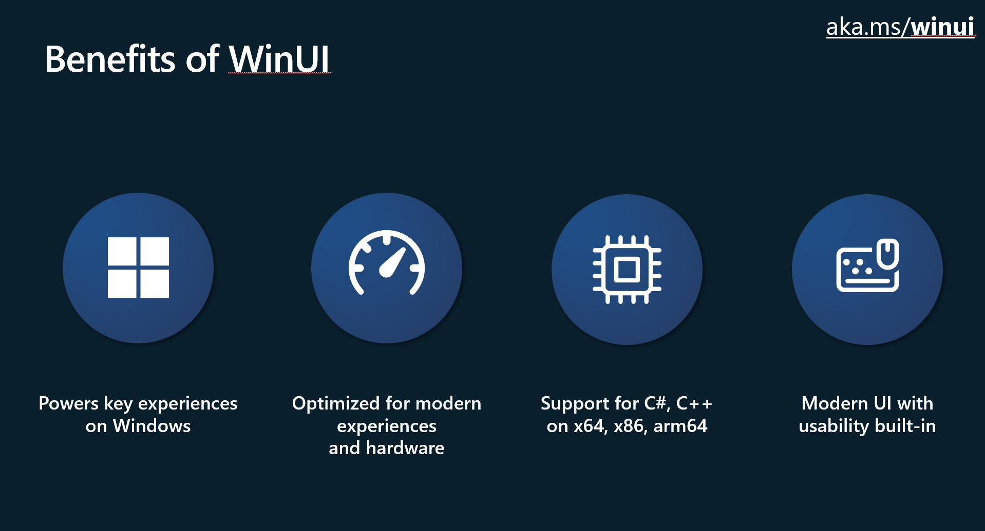
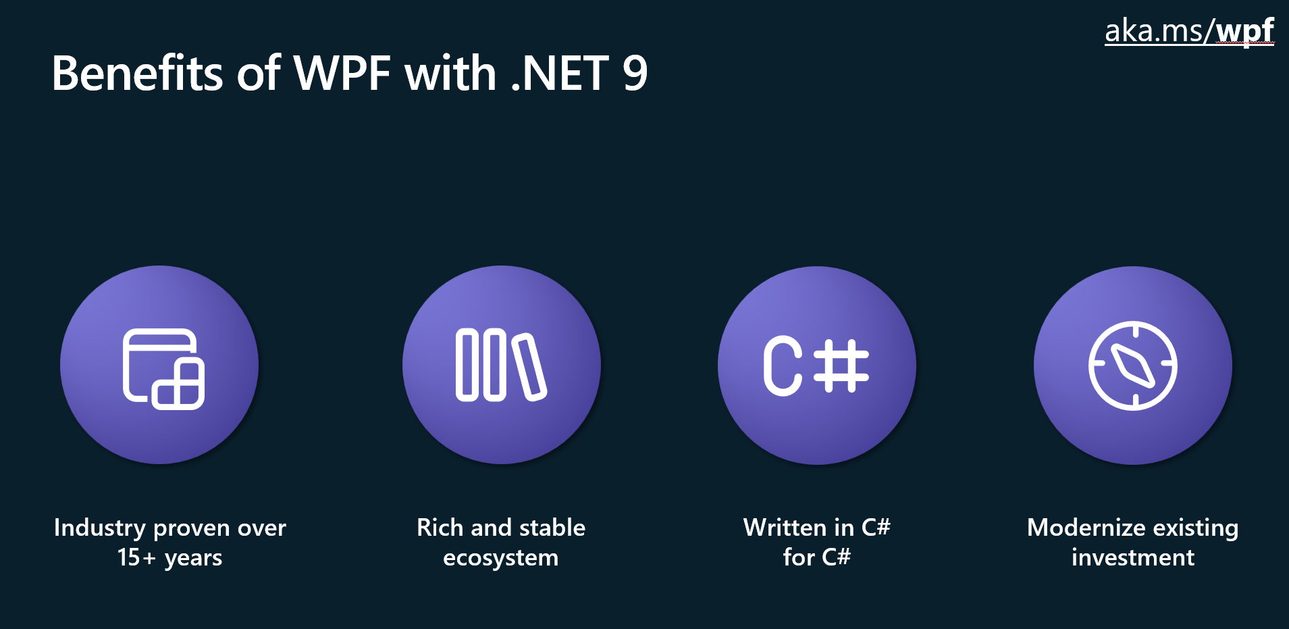
Choosing a UI Framework for Windows
Programming Language
UI Framework
Drag & Drop Designer
UI Design Language
.NET Support
Legacy Windows Support
Touch Support
Cross-platform Options
Long-term Support Options
Current Features and Public Roadmap
Notes:
Some things to consider when deciding what to choose for a new Windows app…
The top recommendations today are WPF and WinUI for native Windows apps. For cross platform .NET development, you’ll typically go with .NET MAUI. For the reasons to use WPF and WinUI, you should watch the “Navigating Win32 App Development with WinUI and WPF” session from Microsoft Build. These two slide images are from that slide deck. I have the link to a GitHub page with links to several sessions and other resources from Microsoft’s WinUI team in my GitHub folder for this presentation. The next slide has that link and more.
What programming language does your team use?
Does your team have experience with existing UI frameworks?
Do they know XAML? Do they like it?
Do you need a UI designer in Visual Studio?
Do you need Fluent Design (or another design system)?
Do you want to work with .NET – maybe flutter or electron works better for your developers.
Do you need to support older Windows versions?
How about touch and pen support? How important is that experience?
Do you need cross-platform? Or do you think you will in the future?
Are you porting an existing solution? Unless you’re on Xamarin or UWP, there’s no reason you NEED to change your selected framework.
How long do you expect to support your app? If you’re in it for the long haul, make sure you’re using a framework that can support upgrading with .NET long-term support versions every two years.
Do the current features of each platform meet your needs? Are there missing features on the product roadmap?
What does Microsoft recommend? Well, if WinUI and Windows App SDK has the features you need, you should choose that. From the Windows team’s perspective, it’s the hero framework moving forward. If it doesn’t have what you need, look at WPF. WPF is also great for building complex, enterprise apps with multiple Windows. If you’re modernizing an existing WPF app, WPF with .NET 8 or 9 is probably your best choice. It’s still getting new features and is not going anywhere.
Absolutely don’t want to touch XAML and love .NET? You can use C# Markup with Uno or MAUI for cross-platform options, or you can stay native to Windows go with the tried-and-true WinForms option.

Slide 22
Resources
Choose the best UI framework – Microsoft Learn Training module: https://learn.microsoft.com/training/modules/windows-choose-best-app-framework/
Overview of Windows Development Options: https://learn.microsoft.com/windows/apps/get-started/
Uno Platform Documentation: https://platform.uno/docs/articles/intro.html
Avalonia Docs: https://docs.avaloniaui.net/
Build a WPF Blazor Hybrid App: https://learn.microsoft.com/aspnet/core/blazor/hybrid/tutorials/wpf
My Books on Amazon: https://www.amazon.com/stores/author/B08WLD35BX
About Me with Social Links: https://about.me/alvinashcraft
My session materials on GitHub: https://github.com/alvinashcraft/speaking/
Notes:
Here are some resources you can use to help your team decide which platform to choose for your next project.
You can get this slide deck on my GitHub “speaking” repo (alvinashcraft/speaking), along with a larger list of links and the two Visual Studio solutions I used today.

Slide 23
Questions?
Thank you!
Contact: alashcraft@gmail.com
Notes:
That’s it!
Any other questions or thoughts?
If you have questions or want to chat later, this is where you can find me this week. I’ll also have copies of my Learn WinUI 3 book to give away at the Tuesday and Thursday receptions. Find me at the Microsoft Learn table.

